Slide 1
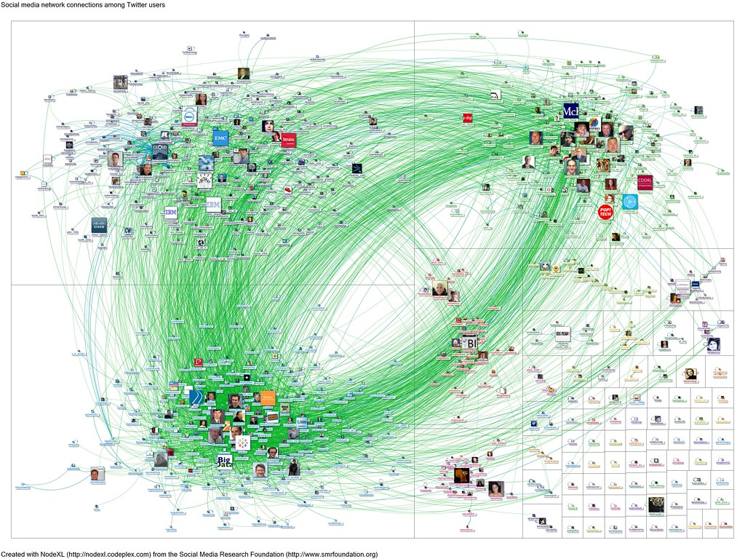
Web Document Classification using KNN
2021-CS-10 Usama Mehboob
2021-CS-38 Ali Haider

Slide 2
Agenda
Abstract
Introduction
Background
Solution
Methodology
Implementation
Evaluation
Conclusion

Slide 3
Introduction
Efficient organization and categorization of web content are essential for effective information retrieval.
This project utilizes the K-Nearest Neighbors (KNN) method with a graph-based approach for web document classification.

Slide 4
Background
Traditional methods struggle with the dynamic and unstructured nature of web data.
Sophisticated approaches are needed for accurate classification.
Machine learning techniques and graph-based representations offer promising solutions.

Slide 5
Solution
A comprehensive machine learning pipeline is employed, covering data collection, preprocessing, feature extraction, model development, and evaluation.
Technologies such as Beautiful Soup and NLTK are utilized for web scraping and text preprocessing.
Graph-based representations capture semantic relationships, while the KNN algorithm enables accurate classification.
Performance is evaluated using metrics like accuracy, precision, recall, and F1 score.

Slide 6
Methodology
The methodology involves several key stages:
Data collection
Preprocessing
Graph construction
KNN implementation.

Slide 7
Data Collection
Automated data collection using Python script.
Web scraping from various sources, overcoming challenges faced during the process.

Slide 8
Preprocessing
Text undergoes standard preprocessing steps, including stopword removal, stemming, tokenization, and removal of non-alphabetic characters, numbers, special characters, commas, full stops, and emojis.

Slide 9
Graph Construction
Documents are transformed into graph representations using the NetworkX library.
Preprocessed data is split into training and test sets for model development and evaluation.

Slide 10
Training Data Using KNN Algorithm
Identification of Maximum Common Subgraph.
Calculation of distance matrix.
Implementation of KNN algorithm using common subgraphs for classification.

Slide 11
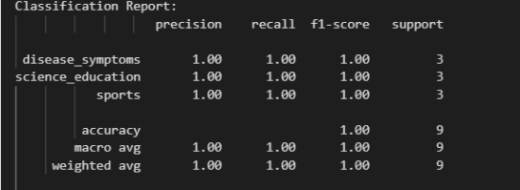
Evaluation Metrics
Accuracy
Precision
Recall
F1 score

Slide 12
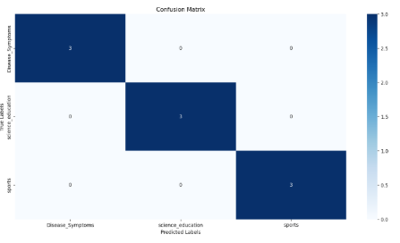
Evaluation Metrics
Confusion matrix for performance evaluation.

Slide 13
Conclusion
In this study, we implemented the K-Nearest Neighbors (KNN) algorithm for document classification using common subgraphs as features. By leveraging the structural similarities between documents, our approach achieved promising results in accurately categorizing web content.

